Slide 1

Royal Crown
E-Commerce Platform for Luxury Watches
Student: Sagil Kureshi | Guide: Prof. Nilesh Parghi
Kamani Science College & Prataprai Arts College, Amreli | BCA Semester 5 Mini Project

Slide 2
Index
01
02
Introduction
Advantages & Disadvantages
03
04
Limitations
Software Requirements
05
06
Hardware Requirements
Related Websites
07
08
Project Screens
References

Slide 3
Introduction
Royal Crown is an online luxury watch shopping website built for a seamless and elegant shopping experience.
User Registration & Login
Admin Login & Product Management
Browse Luxury Watches
Secure Authentication
Responsive Design

Slide 4
Advantages & Disadvantages
Advantages
Disadvantages
Easy Online Shopping
User Friendly Interface
Secure Login System
Responsive Website
Fast Product Management
Internet Connection Required
Online Payment Not Implemented
Depends on Server Availability

Slide 5


Project Limitations
Only Admin Can Manage Products
Internet Connection Required
Limited Payment Options
No AI Recommendation System
No Email Notification Feature

Slide 6





Software Requirements
Frontend
Backend
Database
HTML5 · CSS3 · JavaScript · Bootstrap
Node.js · Express.js · EJS
MongoDB Atlas
Dev Tools
Operating System
VS Code · Git · GitHub · MongoDB Compass
Windows 10 / Windows 11

Slide 7


Hardware Requirements
Processor
Intel Core i3 or Higher
RAM
4 GB Minimum · 8 GB Recommended
Storage
20 GB Free Space
Display
1366 × 768 Resolution or Higher
Internet
Active Internet Connection
Peripherals
Keyboard & Mouse

Slide 8





Related Websites
Rolex
Omega
Tissot
Longines
www.rolex.com
www.omegawatches.com
www.tissotwatches.com
www.longines.com
Ethos Watches
www.ethoswatches.com

Slide 9
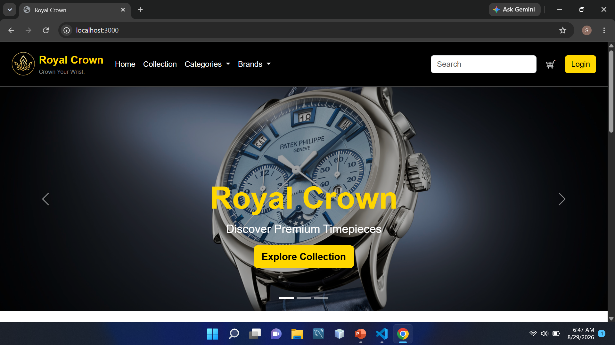

Slide 10
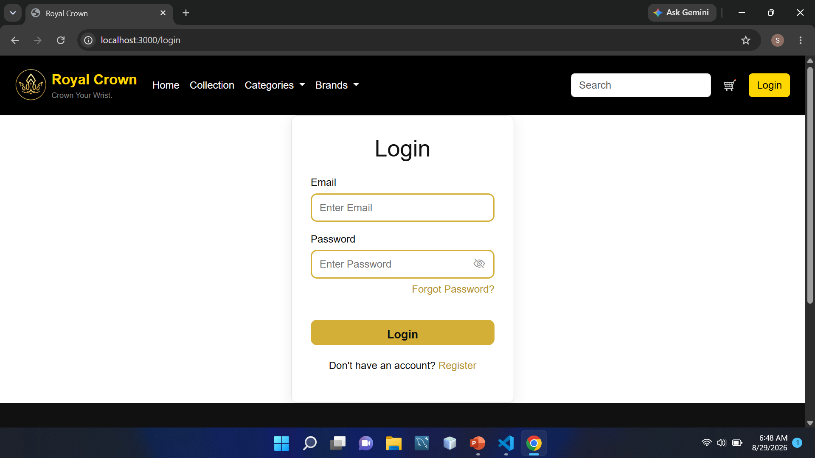

Slide 11
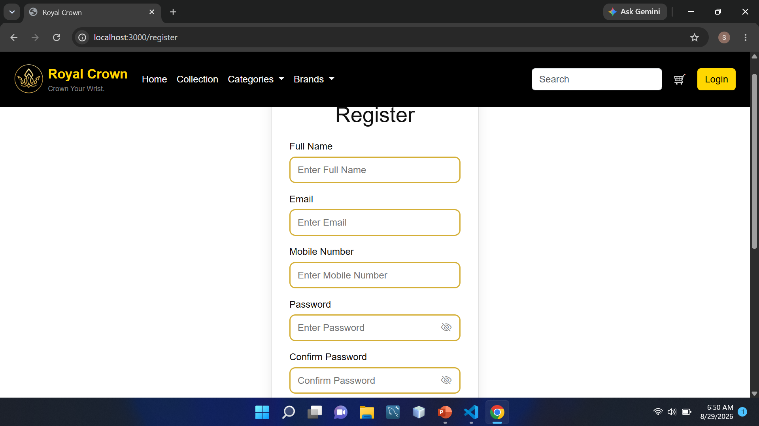

Slide 12

References
https://developer.mozilla.org
https://getbootstrap.com
https://nodejs.org
https://expressjs.com
https://mongoosejs.com
https://www.mongodb.com
https://ejs.co
https://github.com
THANK YOU

